Slide 1
Level 4/5 Group 18
Nomi-No-Sakune
Blake Hewitt, Elliot Dewhurst & Guy Zawada

Slide 2
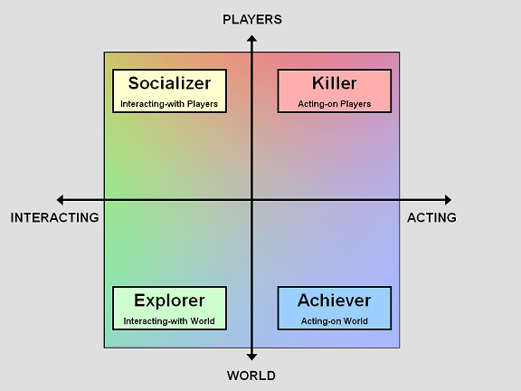
What’s Our Idea?
Genre: Physics-Based, 2D, Sumo style, 1 on 1 arena game
Platform: Desktop PC for now…
Objective: Push your opponent off the arena
Target Demographic: Males aged 14+, Aimed at the ‘Killer’ player type
Reference Image: http://www.gamasutra.com/view/feature/6474/personality_and_play_styles_a_.php?print=1

Slide 3
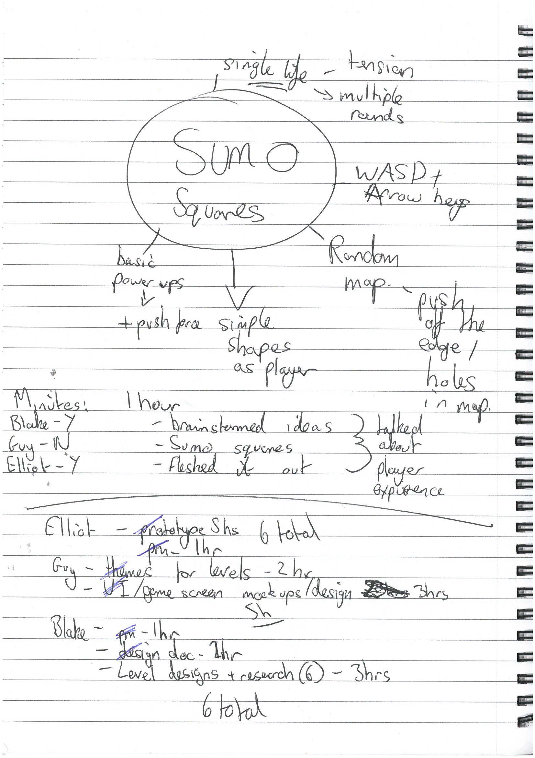
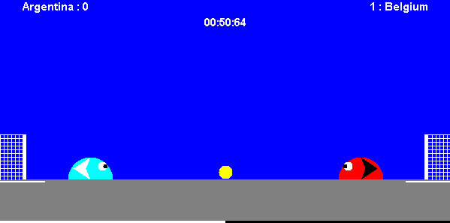
Previous Game Idea
Slime Soccer

Slide 4
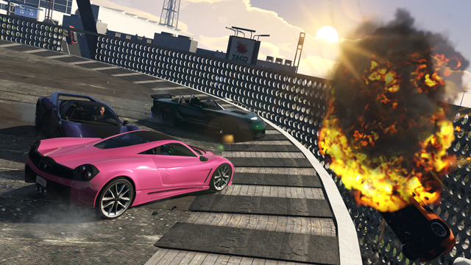
Inspirations for the idea
Sumo Cars – GTA V Multiplayer Minigame

Slide 5
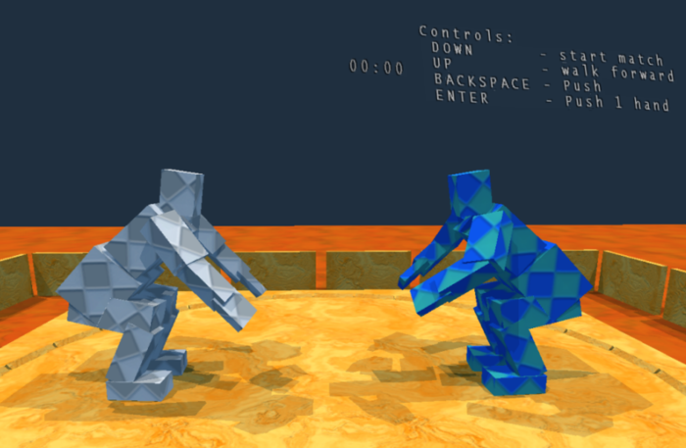
Inspirations for the idea
Sumotori
http://www.gravitysensation.com/sumotori/

Slide 6
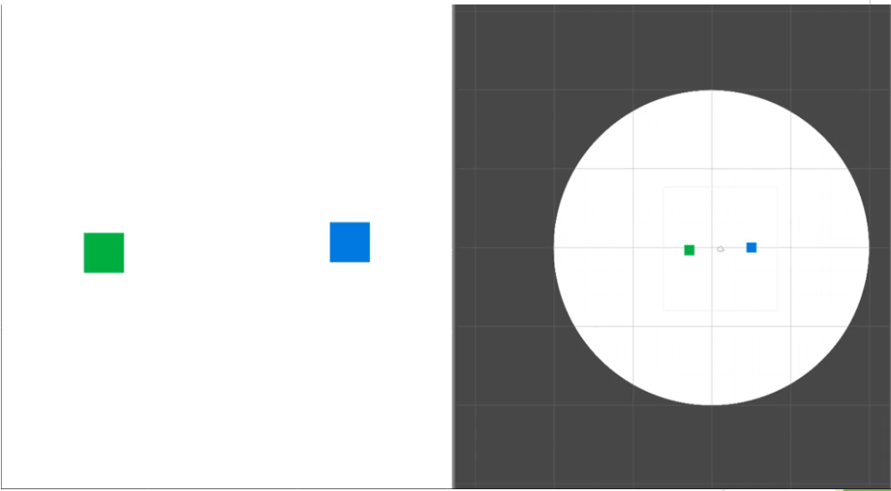
Early Prototype

Slide 7

Gameplay Demo
https://www.youtube.com/watch?v=FnG8jelduFg

Slide 8

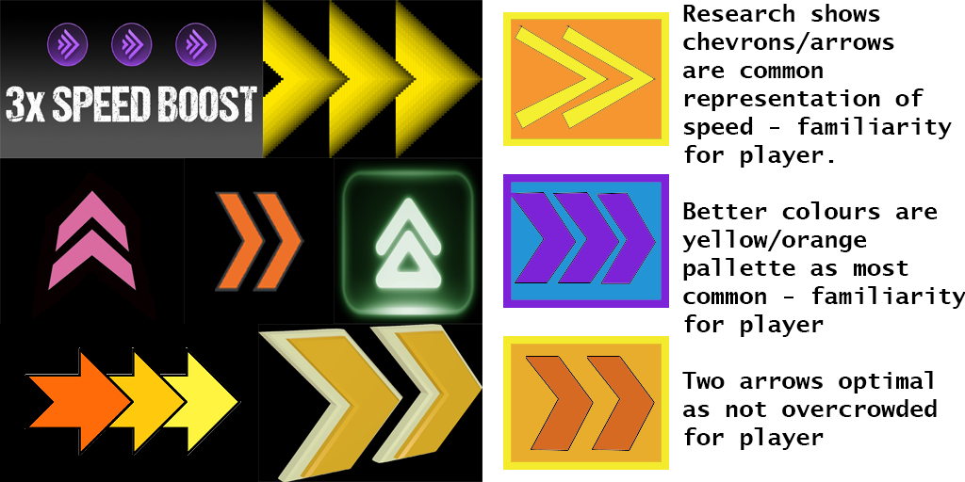
Mechanics
Physics-based pushing
Boost Mechanic
Avoidance of opponent and obstacles
Awareness of round timer

Slide 9
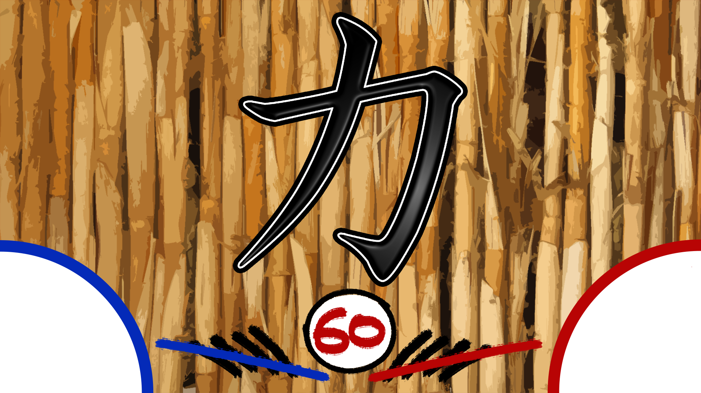
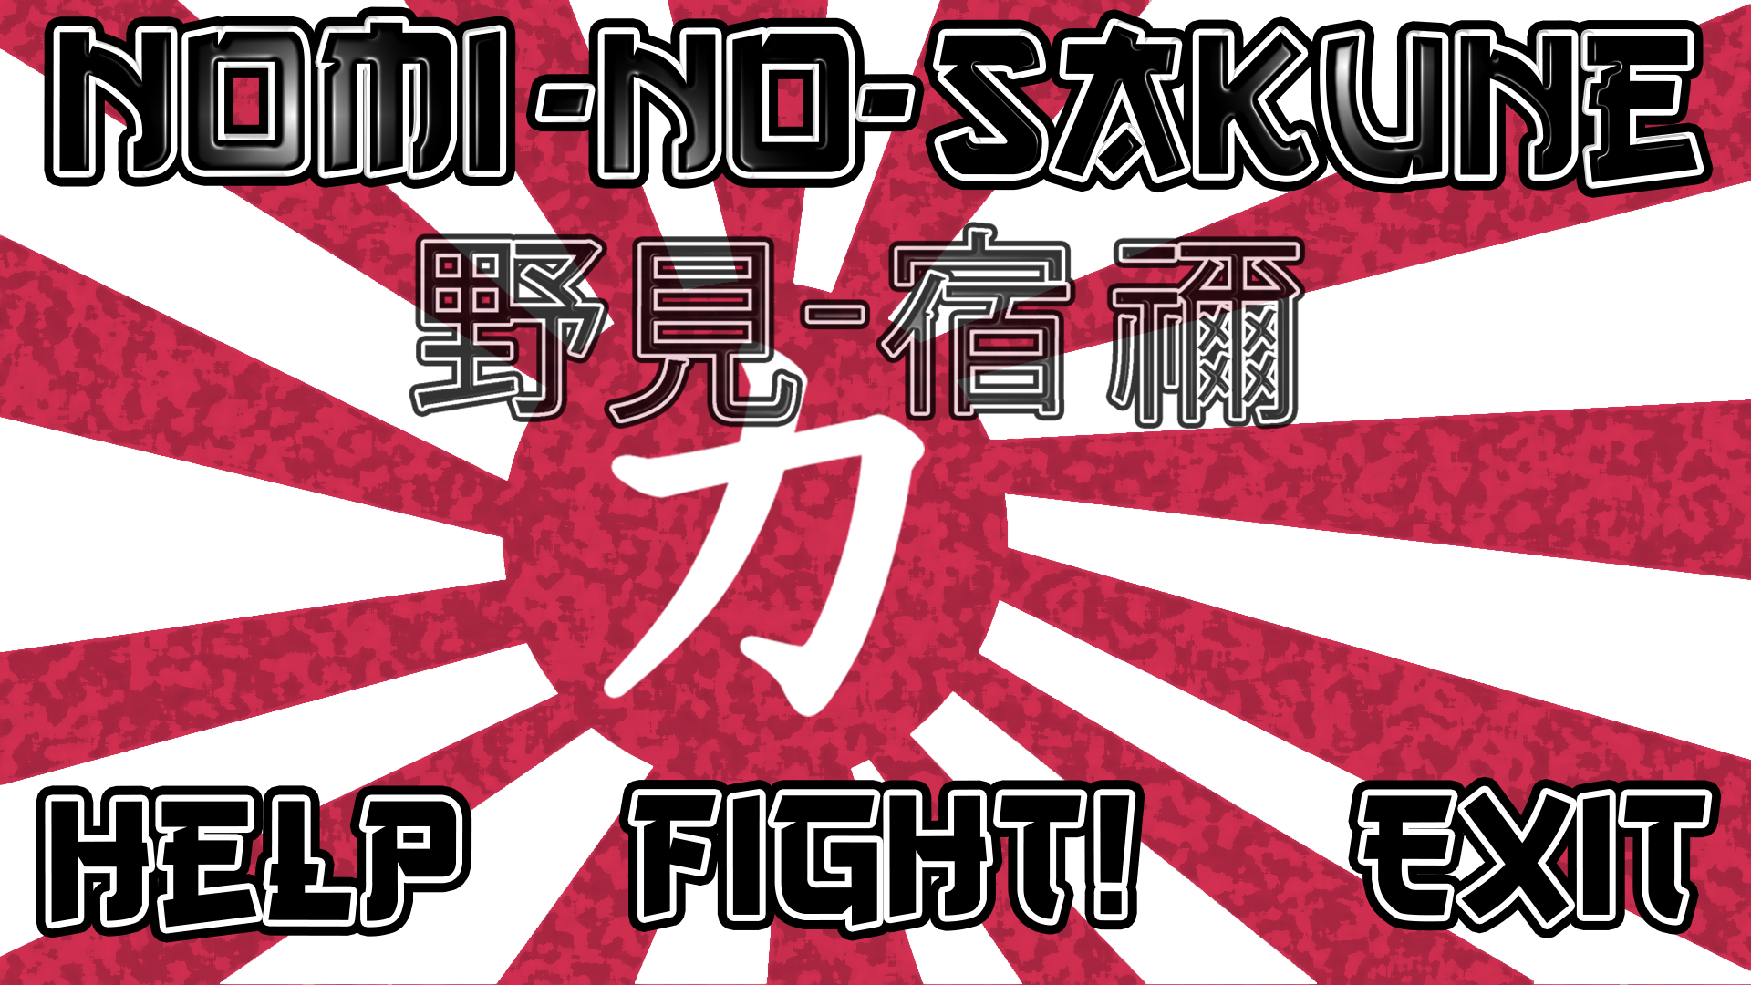
Design
Japanese-inspired theme
Quick-fire Rounds, multiple rounds per match
Strategic, risk and reward based power-up placement

Slide 10
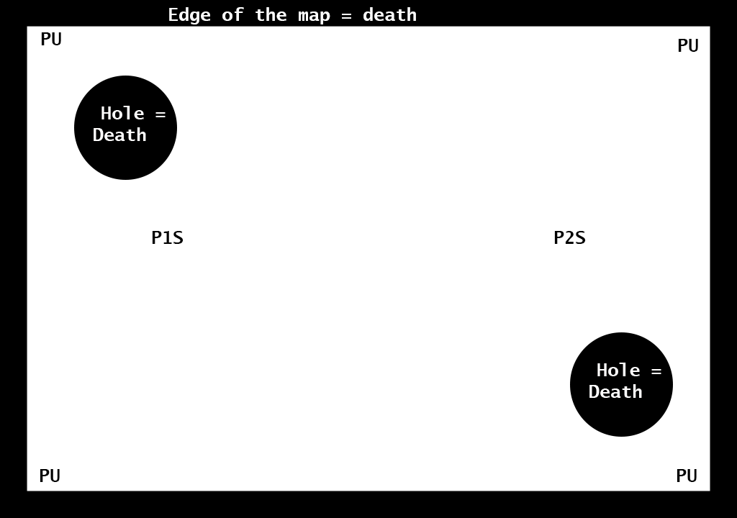
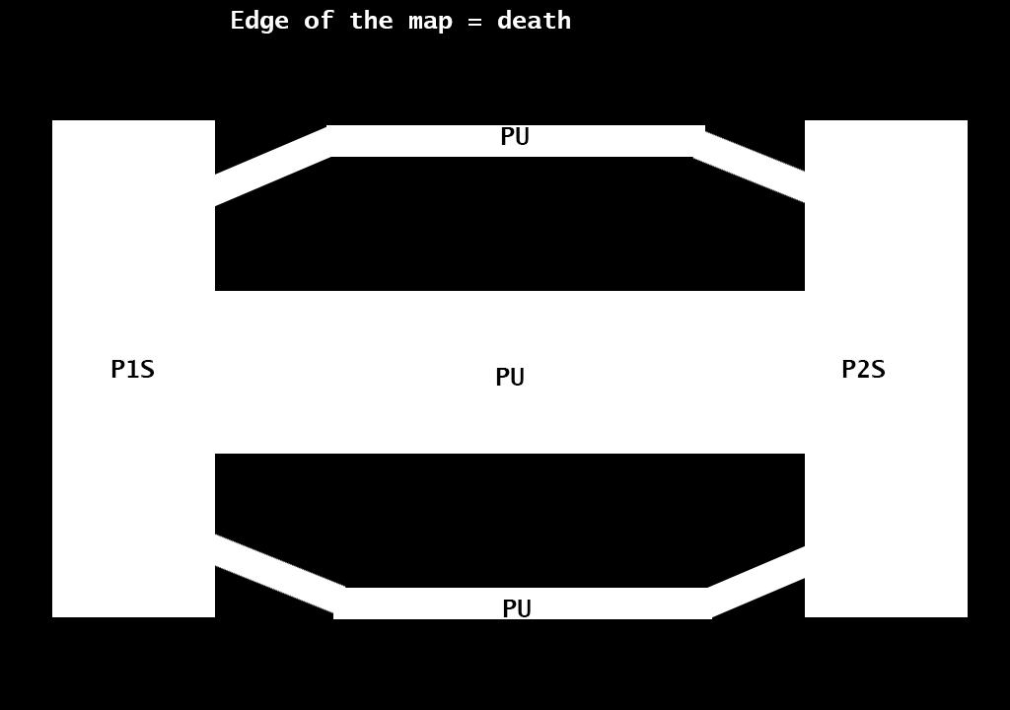
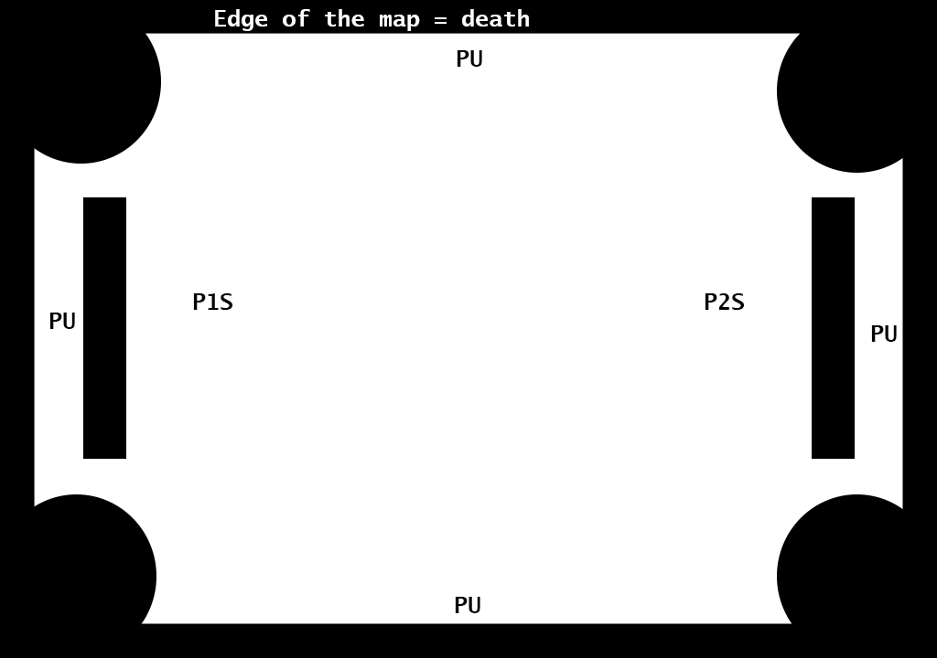
Level Designs

Slide 11
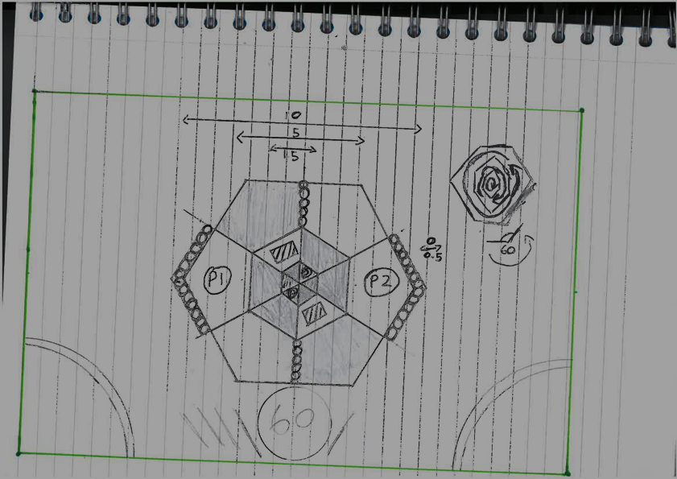
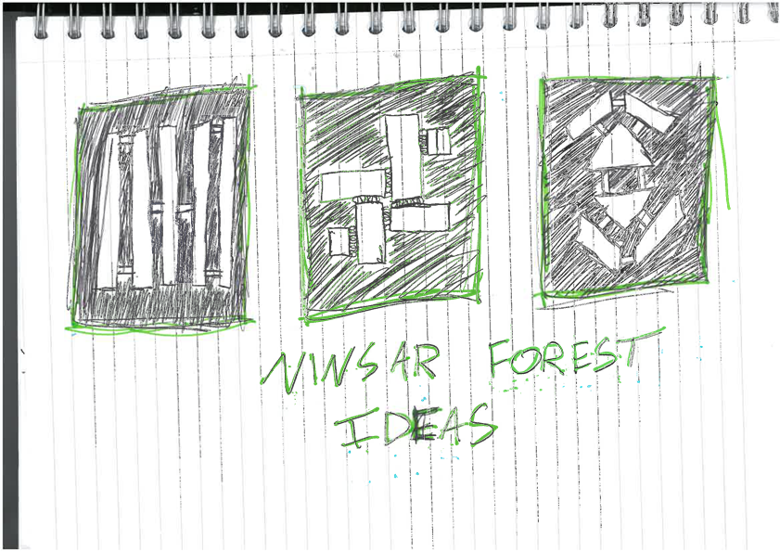

Slide 12
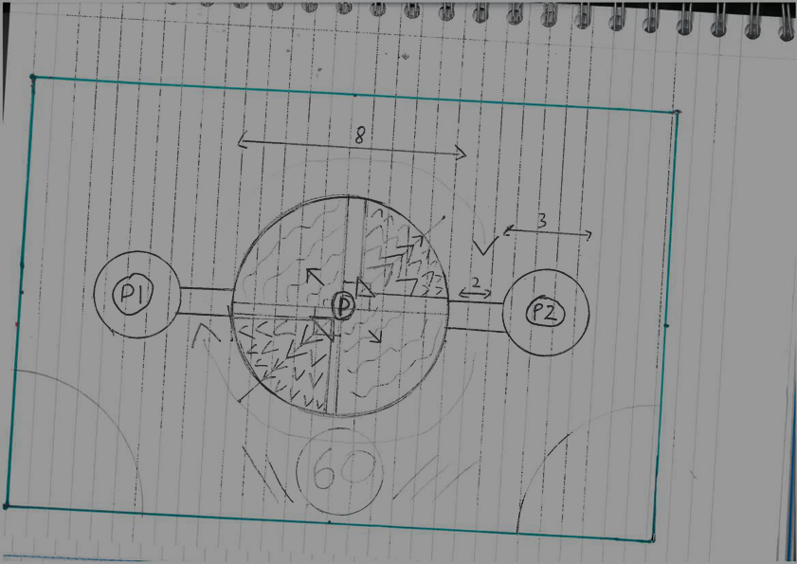
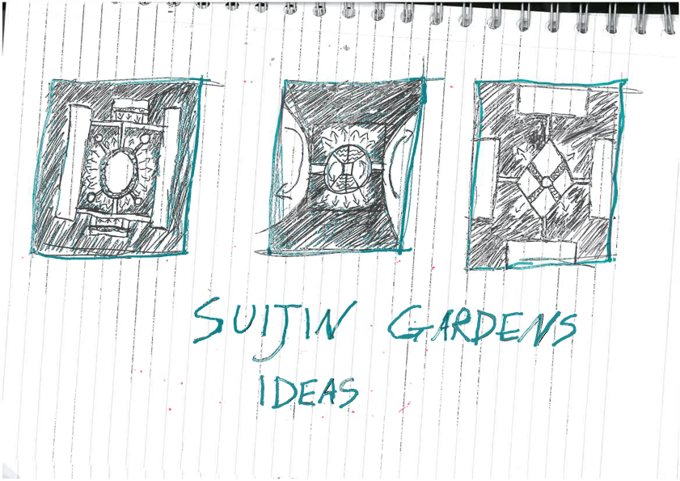

Slide 13





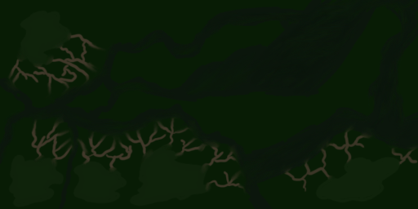
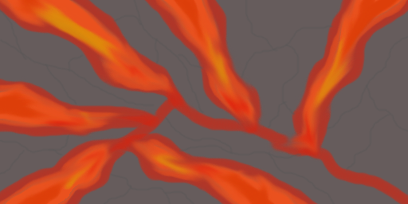
Level Design Details
Power Ups – Increase Mass, Increase Pushing Force, Increase Speed
Obstacles in the level
Random level for each round

Slide 14



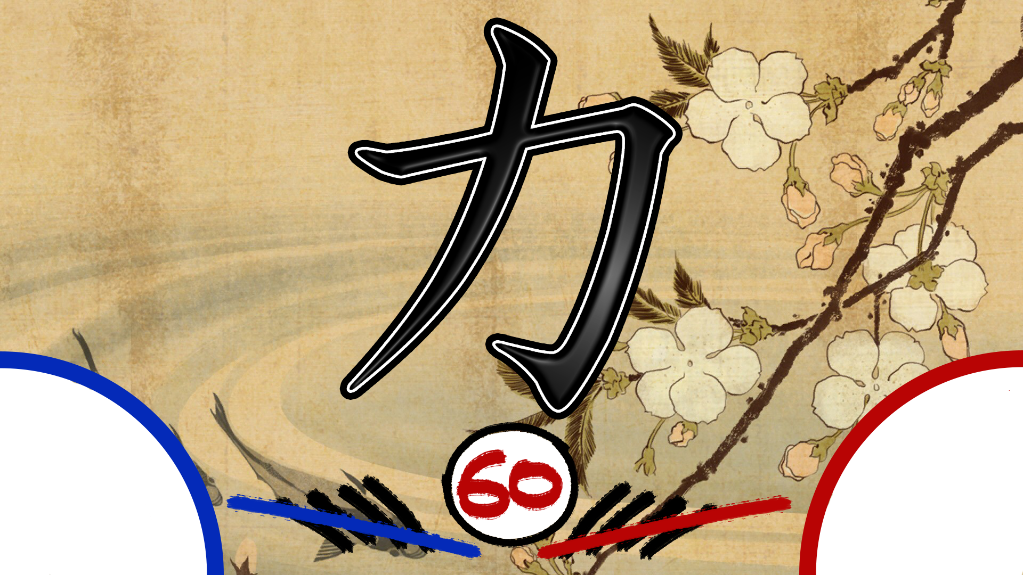

UI/Screen Mock Up

Slide 15
Playtest Feedback Overview
Physics and Movement was too slippery
Camera needs work, too zoomed in.
Remove powerups and obstacles which slow the player down
No help screen (Fixed this sprint)

Slide 16
Future/Stretch Goals
Based on playtesting feedback, in order of importance…
More Levels to choose from
Improve player character movement, make it less slippery
Improve Camera Zooming

Slide 17
Questions?

